Slide 1
Group Name : Dream Crushers
Name : Aiman Lameesa
Email: st122876@ait.asia
Country: Bangladesh
College: Asian Institute of Technology
Specialization (Data Science, NLP, Data Analyst): Data Science
“Customer Segmentation” dataset is selected for my group project.

Slide 2
Problem Description
XYZ bank wants to introduce their Christmas offers to their customers. But they do not want to roll out the same offer to all their customers for some reasons:
It will not be profitable to introduce the same offer for different types of customers.
It is also not efficient and beneficial for them to manually understand the hidden patterns in their customer data.
That is why, they decided to initiate personalized offers to different sets of customers and approached an analytics company, to help them to understand their customer behaviors. They mentioned that they prefer to have at most 5 groups of customers.

Slide 3
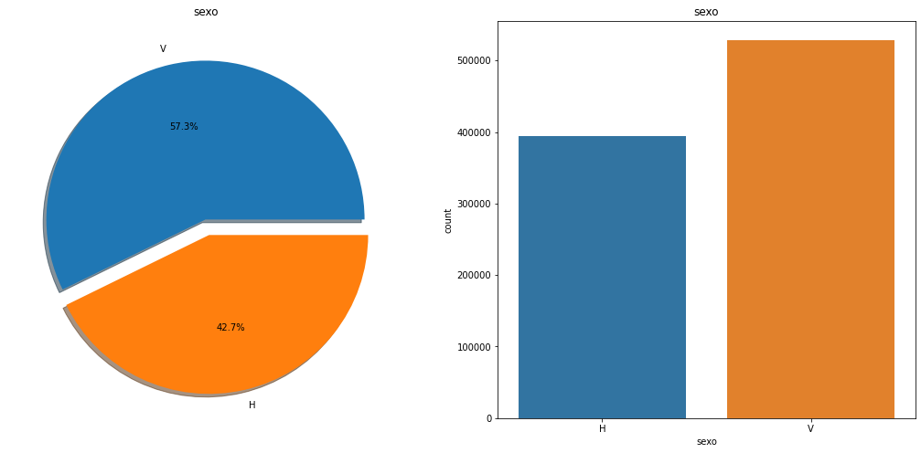
Exploratory Data Analysis
Since the bank has more customers of sex “V”, they can introduce more personalized offers for them.

Slide 4
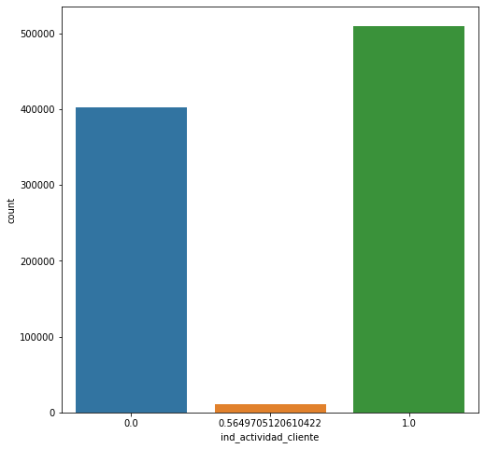
Exploratory Data Analysis
Since the bank has more active customers than the inactive ones, they can think of offering the active customers during the Christmas. Thus, they can motivate the inactive customers to be active also.
Also, the number of inactive customers is not negligible. So, they can have different offers for these two different groups.

Slide 5
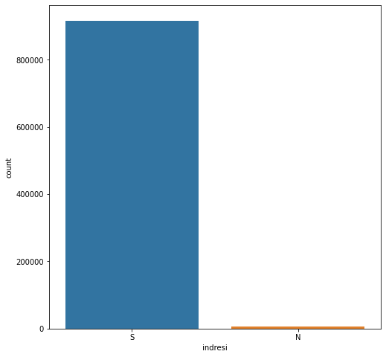
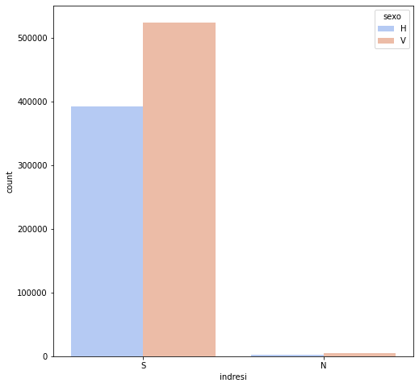
Exploratory Data Analysis
Since the bank has more resident clients of sex “V”, it will be profitable to introduce Christmas offers for them.

Slide 6
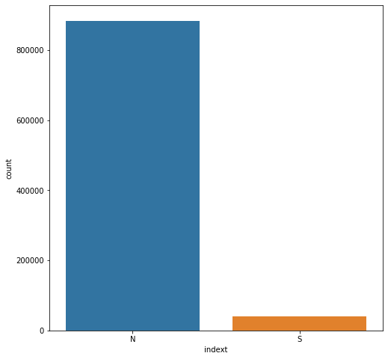
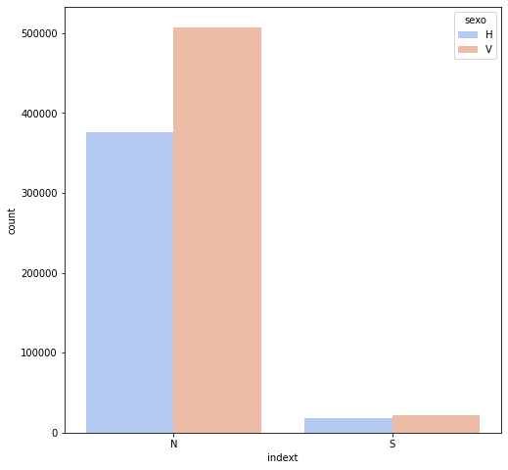
Exploratory Data Analysis
The bank has a few number of foreign customers, which is negligible. They can just concentrate on the citizens of that country to introduce Christmas offers.

Slide 7
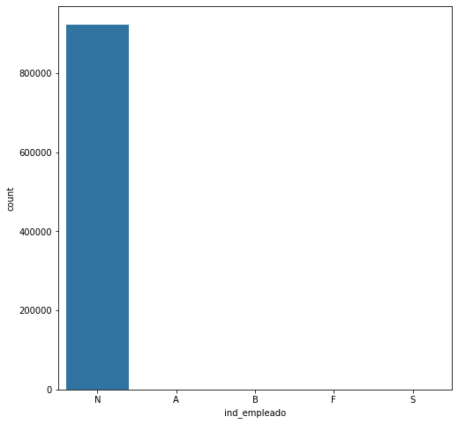
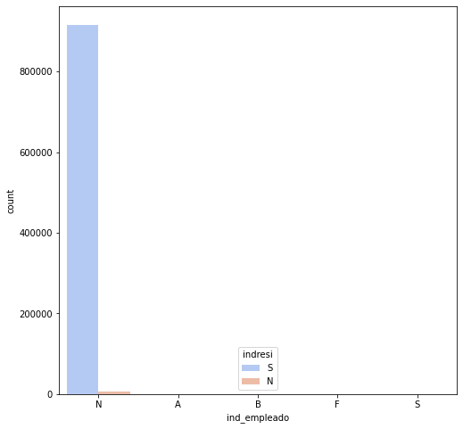

Exploratory Data Analysis
Majority of the bank customers are not employed, whereas most of them are both residents and citizens of the country. The bank will be highly profitable if it introduces offers for them.

Slide 8
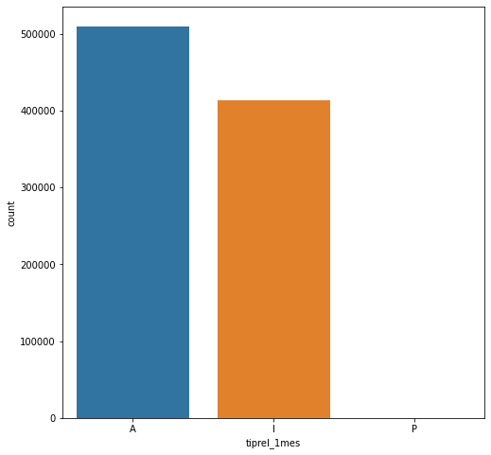
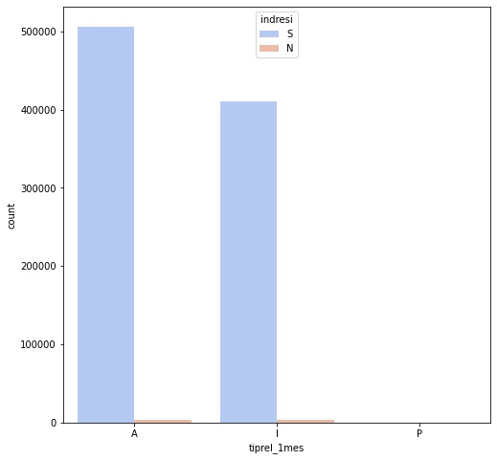
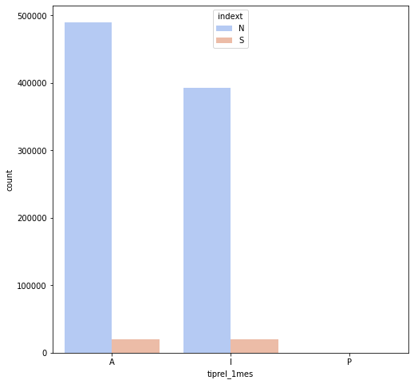
Exploratory Data Analysis
There are both active and inactive customers at the beginning of the month and most of them are both residents and citizens of the country. The bank should introduce offers for them in order to earn profits.

Slide 9
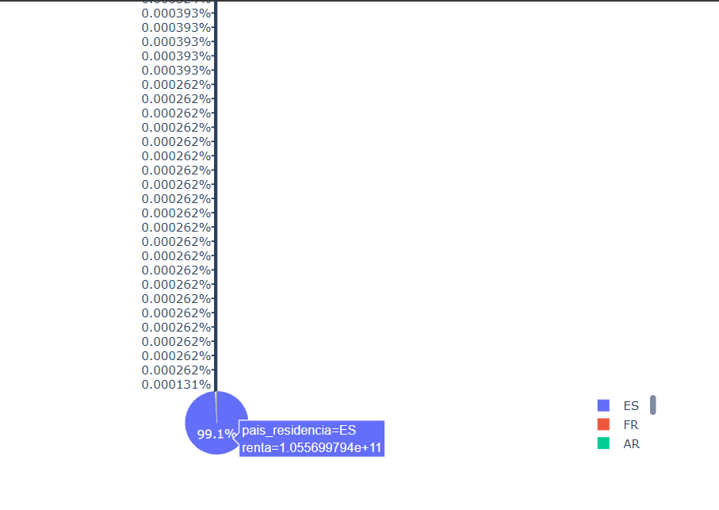
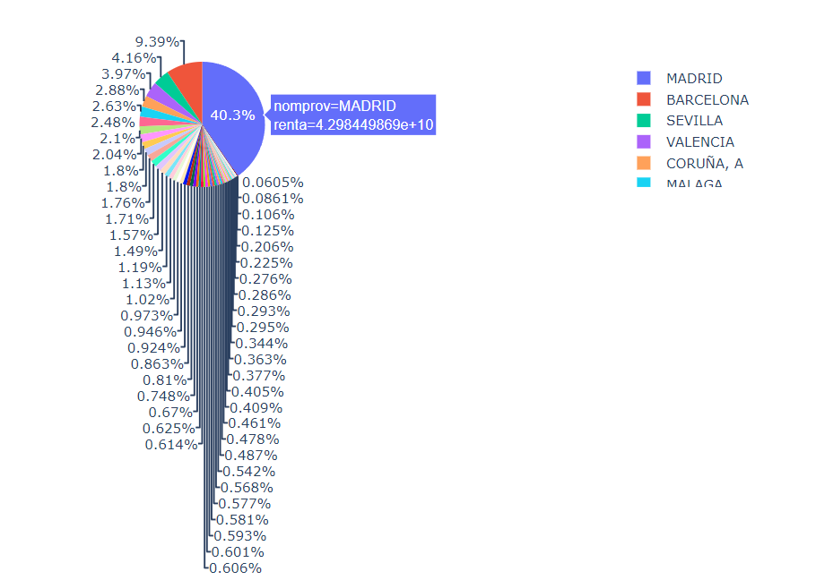
Exploratory Data Analysis
Since most of the customers are from “ES” country “Madrid” province with high gross income of the household, the bank should introduce Christmas offers for them.

Slide 10
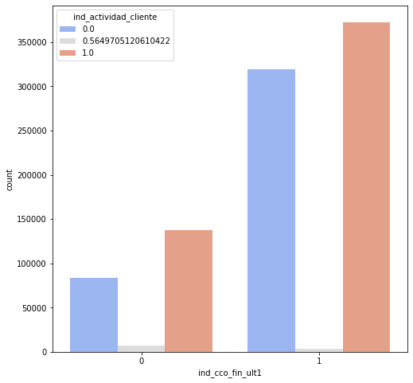
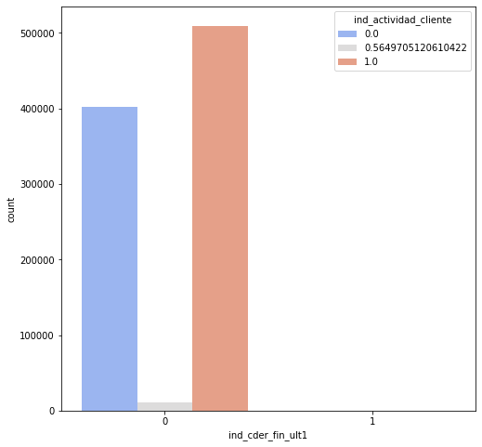
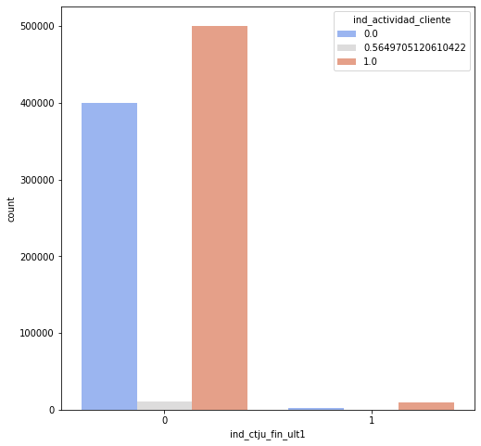
Exploratory Data Analysis
The majority of the customers only have the current accounts. Since they do not have the derivada account or junior account, the bank can focus on these facilities while introducing offers.

Slide 11


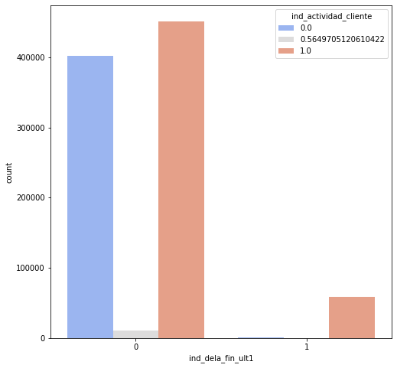
Exploratory Data Analysis
Also, most of the customers do not have any deposit, the bank can introduce special offers on having deposits, specially short-term and medium-term deposits.

Slide 12
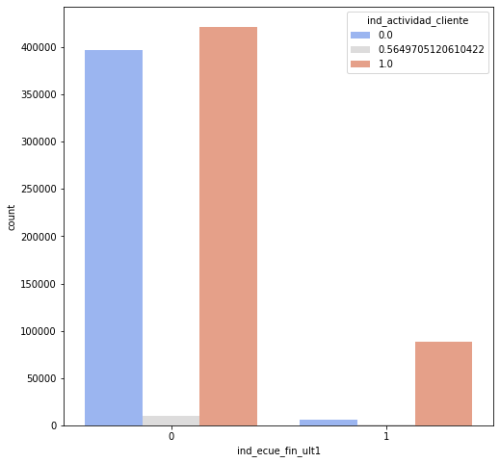
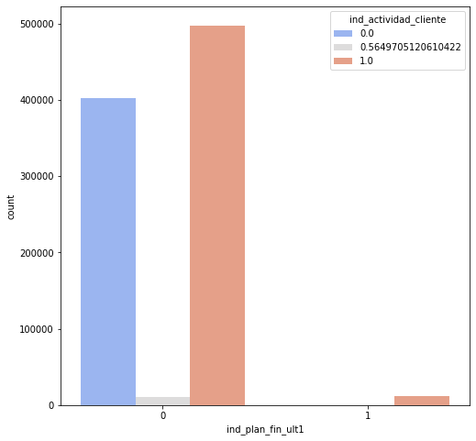
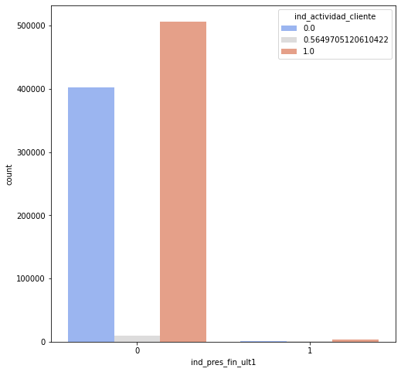
Exploratory Data Analysis
Moreover, the bank can introduce Christmas offers for creating E-account, saving pensions, loans etc since most of the customers do not use these facilities.

Slide 13
Recommended Modeling Technique
To segment the groups of the customers, we can use unsupervised machine learning algorithms, such as, K-means clustering in this given dataset. There are other clustering algorithms to segment the customers into different groups but K-means clustering is the most popular one to solve segmentation problems given some features.
K-means clustering utilizes some clusters to calculate the features for each customer. Thus, it comes to a conclusion on how the customers should be segmented into different groups. So, this algorithm should be implemented in the next step for customer segmentation in this project.
Some other algorithms, i.e., hierarchical clustering can be implemented to compare the results and come to a conclusion.

Slide 14
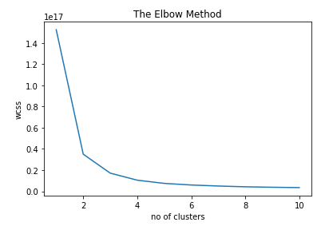
Model Selection and Model Building
K-means clustering is selected for customer segmentation, where the Elbow method is used to obtain the number of clusters to segment the customers into different groups. The Elbow method is experimented from 1 cluster to 10 clusters. From the obtained result, we get two sharp curves at 2 and 3 clusters, which indicates that the number of groups for the customers given in the dataset should be either 2 or 3.

Slide 15
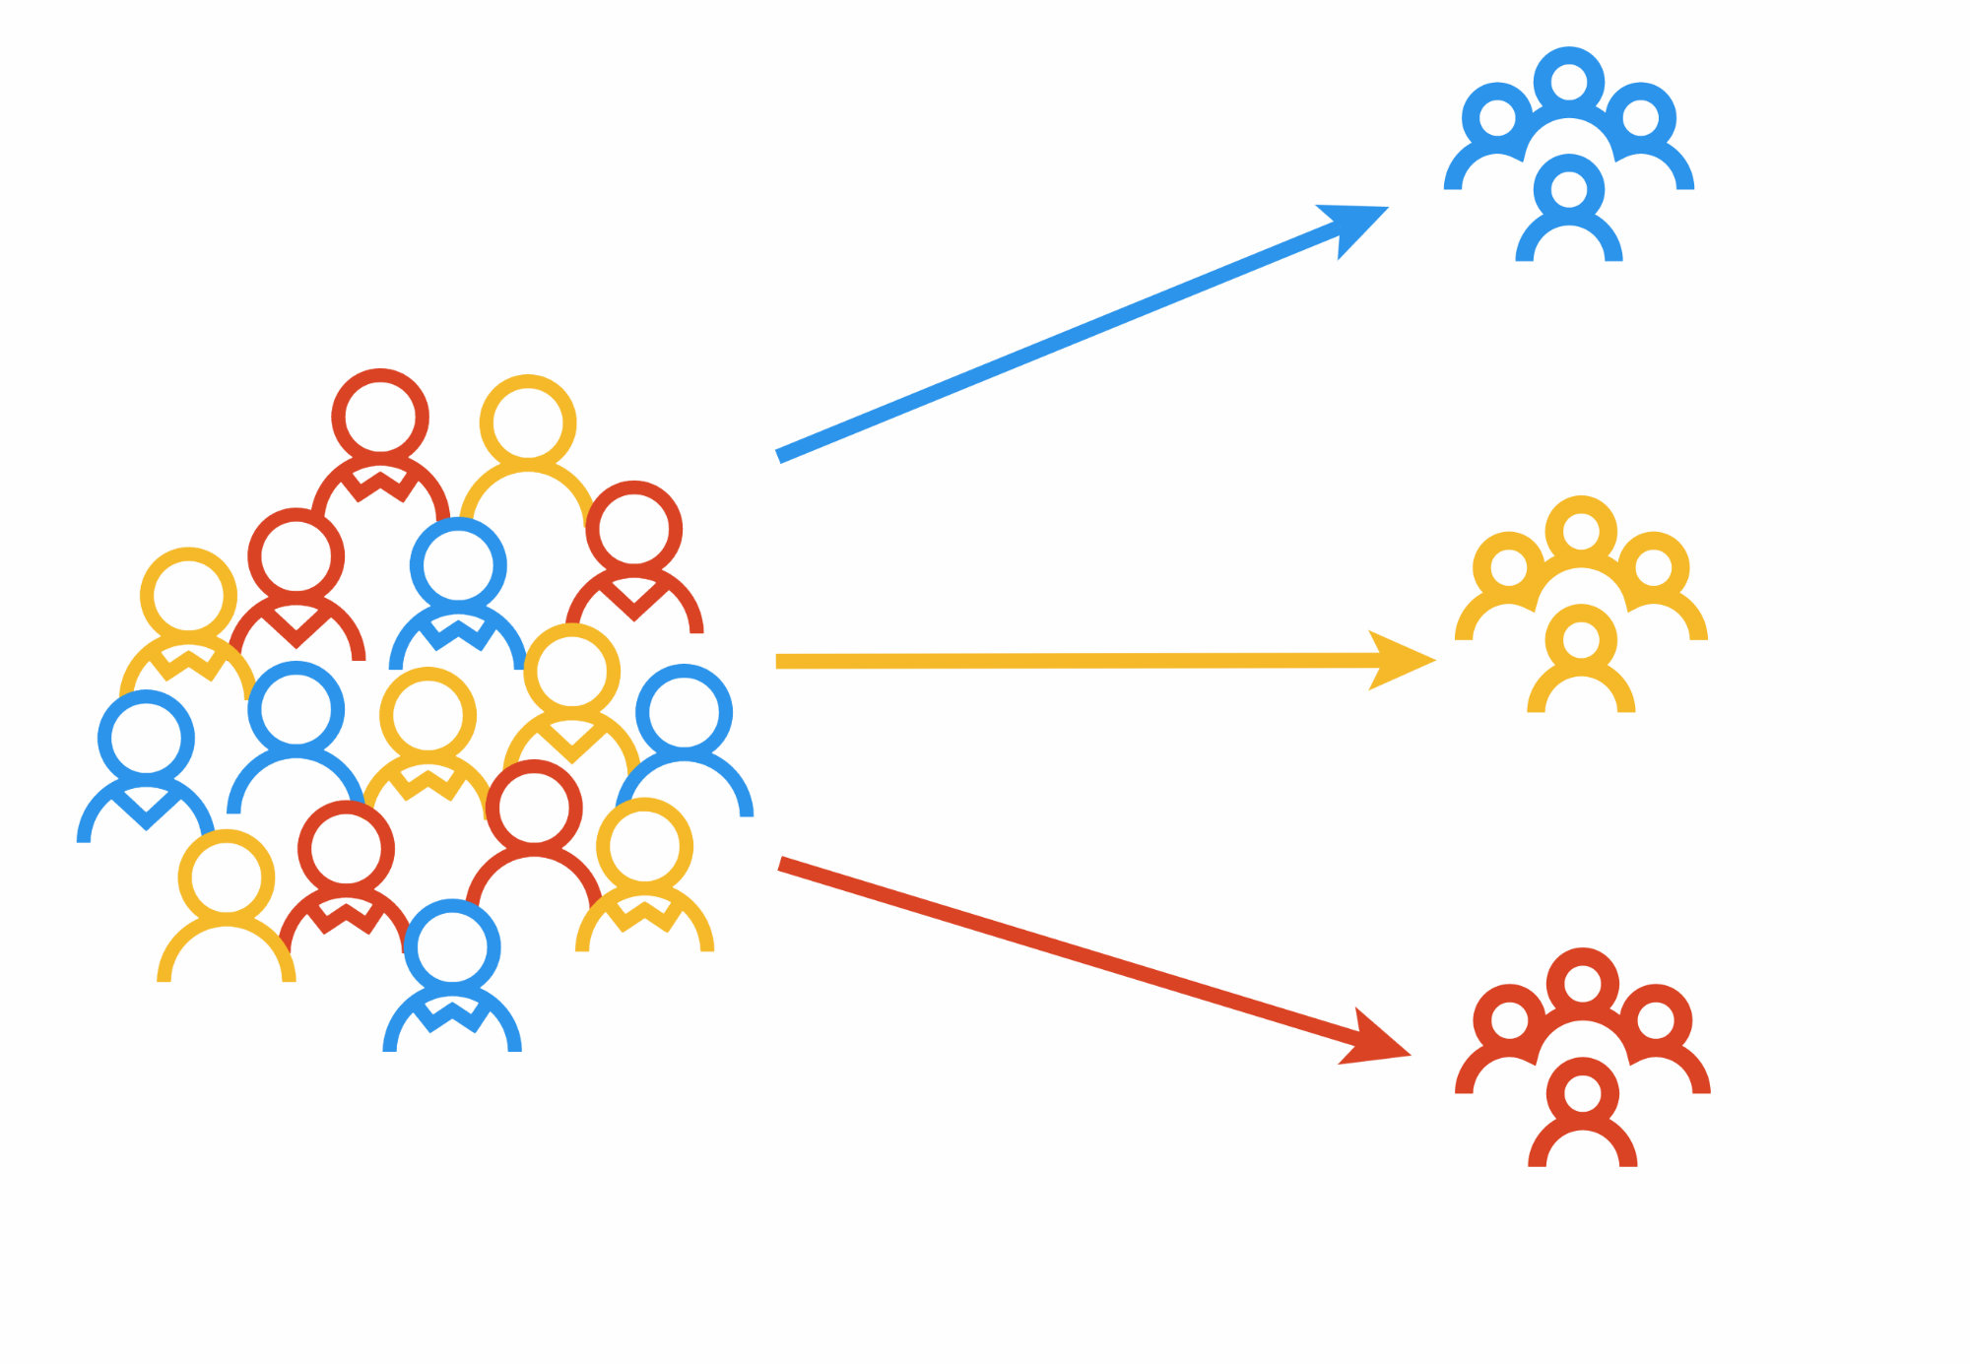
Conclusion
It is recommended to the bank to introduce Christmas offers to customers considering that their customers can be segmented into either 2 or 3 groups.

Slide 16
Thank You!
Github Repo Link:
aimanlameesa/Week-13 (github.com)

